Slide 1
Children’s Dyslexia Center of Southern Illinois
Impacting the Lives of Children

Slide 2
The Challenge of Dyslexia
A small boy sits at his desk, looking down at his open book as his classmates read aloud. He wrinkles his forehead and squints his eyes but the letters and words he sees are jumbled, twisted, and sense-less. He grips the book tighter, holds his breath and makes a silent wish that the teacher will not call on him …
This child has dyslexia, a learning disability that affects 1 out of every 5 children. He needs help to overcome it before it sets him back emotionally as well as educationally. Where will he get the help he needs?
Notes:
You can immediately impact the lives of 20+ children residing in your community
The Children's Dyslexia Center in Belleville IL tutors children with dyslexia in both Illinois and Missouri at no charge to the child or their family.
The program offered at the Children’s Dyslexia Centers Inc. provides the most effective treatment of its kind in battling this reading disorder. No one else in our community has a program remotely like it with one-on-one professional tutoring.
It costs $5000 per child per year which the CDC raises through local fundraising.
CDC is a 501(c) non-profit organization so donations are tax deductible.
If you have a bachlor's degree and would like to become certified in tutoring children with dyslexia the CDC provides training for free.

Slide 3
Children’s Dyslexia Center Can Help!
Our Mission | Our Success
1) Tutor Children | We provide one of the most effective professional reading and written language instruction programs to children with dyslexia; that the Public Schools can’t.
 | Children are tutored one-on-one, twice a week after regular school hours
 | Curriculum tailored to each individual child, and progress is made in small, readily quantifiable steps.
 | Children will improve their grade reading level by one or two grades in 2 years.
 | Tutoring is provided at no charge to children, regardless of economic status, from early elementary through high school who have reading disabilities.
“Tell me, and I forget. Teach me, and I remember. Involve me, and I learn!” ~ Benjamin Franklin

Slide 4
Children’s Dyslexia Center Can Help! (Cont’d)
Our Mission | Our Success
2) Train Tutors | Our accredited program offers free training for individuals to receive certification as tutors in the Orton-Gillingham approach.
 | The training program is accredited by the International Multisensory Structured Language Education Council
 | School teachers receive training and can potentially earn continuing education credits to become certified tutors.
3) Clinical Research | Advance scientific knowledge of dyslexia through support of clinical research to improve today’s standards and tomorrow’s care.
Overall | The positive impact of early intervention on the lives of these children and their families is enormous, and inspires our commitment to this program.
“Each day when I awake I know I have one more chance to make a difference in someone’s life” James Mann Author

Slide 5
Why we need your help!
25+ students are currently enrolled.
30+ children are on the waiting list and this number continues to grow.
Costs $5,000 a year per child.
Program is 2 years.
Due to the state of our economy, there is greater competition for fundraised dollars and we have had cuts from our corporation.
Notes:
You can immediately impact the lives of 20+ children residing in your community
The Children's Dyslexia Center in Belleville IL tutors children with dyslexia in both Illinois and Missouri at no charge to the child or their family.
The program offered at the Children’s Dyslexia Centers Inc. provides the most effective treatment of its kind in battling this reading disorder. No one else in our community has a program remotely like it with one-on-one professional tutoring.
It costs $5000 per child per year which the CDC raises through local fundraising.
CDC is a 501(c) non-profit organization so donations are tax deductible.
If you have a bachlor's degree and would like to become certified in tutoring children with dyslexia the CDC provides training for free.

Slide 6
How Can You Help?
You can immediately impact the lives of 25+ children residing in our community
Level | Amount | Impact | Recognition
Platinum | $5,000 | 1 child sponsored for a year | Receive 9 X 12 plaque, and banner at all Children’s Dyslexia Center events in 2014/15
Gold | $1,000 | 20 tutoring sessions | Receive 8 X 10 plaque, and banner at all Children’s Dyslexia Center events in 2014/15
Silver | $500 | 10 tutoring sessions | Receive 5 X 10 plaque, and half banner at all Children’s Dyslexia Center events in 2014/15
Bronze | $250 | 5 tutoring sessions | Receive 4 X 10 plaque
1 Session | $50 | 1 tutoring session | Thank You Letter
Office Supplies donations & Volunteering are welcomed!
Donations are Tax Deductible, as we’re 501(c)3 Non-Profit Org
Notes:
We need your help for this year's local fundraising
Options to donate
Platinum: With a $5000 donation 1 child will be sponsored for a full year. Your organization will receive 9 X 12 plaque and your commitment to help will be proudly displayed on a banner at all Children’s Dyslexia Center events in 2014/15.
Gold : With a $1000 donation your organization will receive a 8 X 10 plaque and your commitment to help will be proudly displayed on a banner at all Children’s Dyslexia Center events in 2014
Silver: With a $500 donation your organization will receive a 5 X 10 plaque.
Bronze: With a $250 donation your organization will receive a 4 X 10 plaque
1 Session: With a $25 donation 1 child will be sponsored for an 1 hour tutoring session
Office Supplies donations as well as volunteering are welcomed!

Slide 7
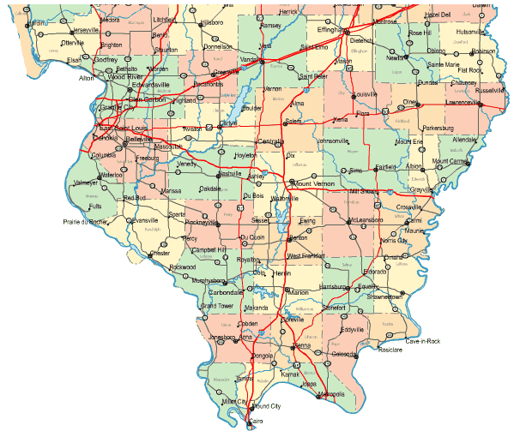
Serving Our Community
The CDC has been located in Belleville since 2002.
Over 16 years, has provided over 15,000 individual lessons and trained over 75 tutors
Serving over 35+ communities:
Addieville
Belleville
Bethalto
Breese
Burksville
Caseyville
Columbia
East St. Louis
Fairview Heights
Freeburg
Glen Carbon
Godfrey
Granite City
Greenville
Highland
Hoyleton
Lebanon
Lenzburg
Marissa
Maryville
Mascoutah
Millstadt
Nashville
New Athens
O’Fallon
Radom
Red Bud
Ruma
Shiloh
Smithton
Swansea
Troy
Waterloo
Woodriver
Arnold in Missouri

Slide 8
Contact Information
Center Director: Michele Johnson
Phone/Fax: (618) 235-9392
E-mail: director@sril092.com
Please visit our website for more information:
www.readwithdyslexia.com
Board of Governors Chair: Brian Coppotelli
Cell 618-971-9411
E-mail: bkcoppo@earthlink.net
Donation Information:
Checks can be made to “Children’s Dyslexia Center – Southern Illinois” and mailed to:
Children’s Dyslexia Center - Southern Illinois
c/o Treasurer
1549 Frank Scott Parkway West,
Belleville, IL 62223 P.O.Box 23954
To open Max’s Story you must exit out of the slideshow then click on the file.
Play Video
Notes:
We need your help for this year's local fundraising
Options to donate
Platinum: With a $5000 donation 1 child will be sponsored for a full year. Your organization will receive 9 X 12 plaque and your commitment to help will be proudly displayed on a banner at all Children’s Dyslexia Center events in 2014/15.
Gold : With a $1000 donation your organization will receive a 8 X 10 plaque and your commitment to help will be proudly displayed on a banner at all Children’s Dyslexia Center events in 2014
Silver: With a $500 donation your organization will receive a 5 X 10 plaque.
Bronze: With a $250 donation your organization will receive a 4 X 10 plaque
1 Session: With a $25 donation 1 child will be sponsored for an 1 hour tutoring session
Office Supplies donations as well as volunteering are welcomed!

Slide 9
Thank You!!!

